Slide 1
CHAPTER ONE INTRODUCTION TO FINANCIAL STATEMENT ANALYSIS
Explain business analysis and its relation to financial statement analysis
Describe component analyses that constitute financial statement analysis
Describe the purpose of each financial statement
Apply two basic financial statement analysis techniques

Slide 2

What is financial statement analysis?

Slide 3
Business Analysis
Business analysis is the evaluation of a company’s prospects and risks for the purpose of making business decisions.

Slide 4

Component Processes of Business Analysis
Business
Environment &
Strategy Analysis
Financial
Analysis
Prospective
Analysis
Accounting
Analysis
Intrinsic Value
Notes:
4

Slide 5
Financial Statement Analysis
Financial
Analysis
Prospective
Analysis
Accounting
Analysis
Accounting analysis is a process of evaluating the extent to which a company’s accounting reflects economic reality.
Financial analysis is the use of financial statements to analyze a company’s financial position and performance, and to assess future financial performance.
Prospective is the forecasting future payoffs
Notes:
5

Slide 6
Business Activities
Planning
Activities
Investing
Activities
Financial
Activities
Operating Activities
Revenues and expenses from providing
goods and services
Notes:
6

Slide 7
Planning activities:
Business plan
Information on company objectives and tactics, market demands, competitive analysis, sales strategies (pricing, promotion and distribution), management performance and financial projection.
Differentiate business analysis from financial statements analysis

Slide 8
Financing activities refer to methods that companies use to raise the money to pay for the company’s needs.

Slide 9
Investing Activities
Investing activities refer to a company’s acquisition and maintenance of investment for purposes of selling products and providing services, and for the purpose of investing excess cash.
Operating assets vs. financial assets

Slide 10
Operating Activities
Operating activities represent the carrying out of the business plan given its financing and investing activities.
Operating activities involve at least five possible components: research and development, procurement, production, marketing and administration.

Slide 11
Financial Statements Reflect Business Activities
Balance Sheet
Income Statement
Statement of Cash Flows
Statement of Shareholders’ Equity
Notes:
In VietNam, the 3rd statement is Explanatory notes
11

Slide 12
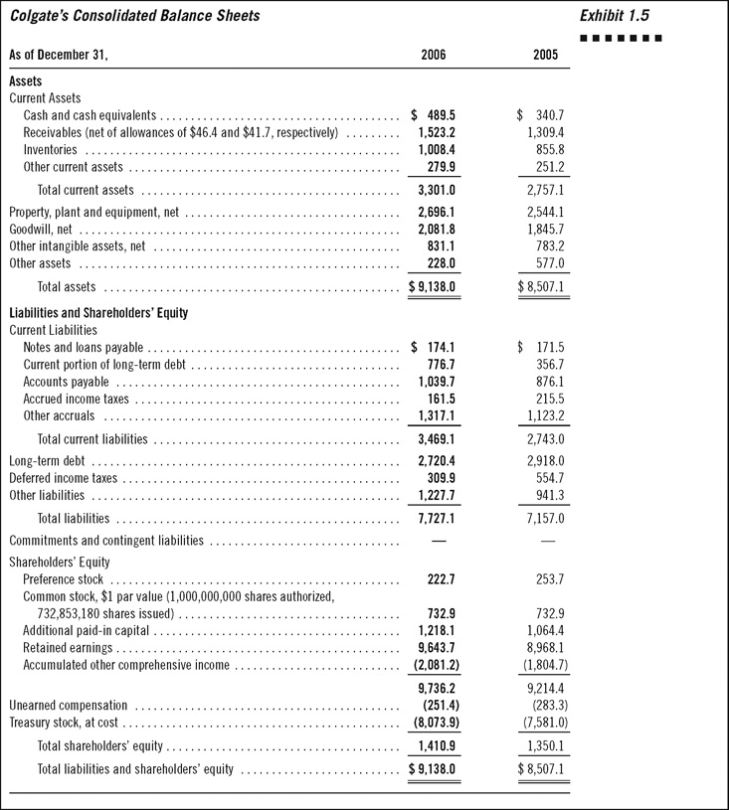
1-12
Notes:
12

Slide 13
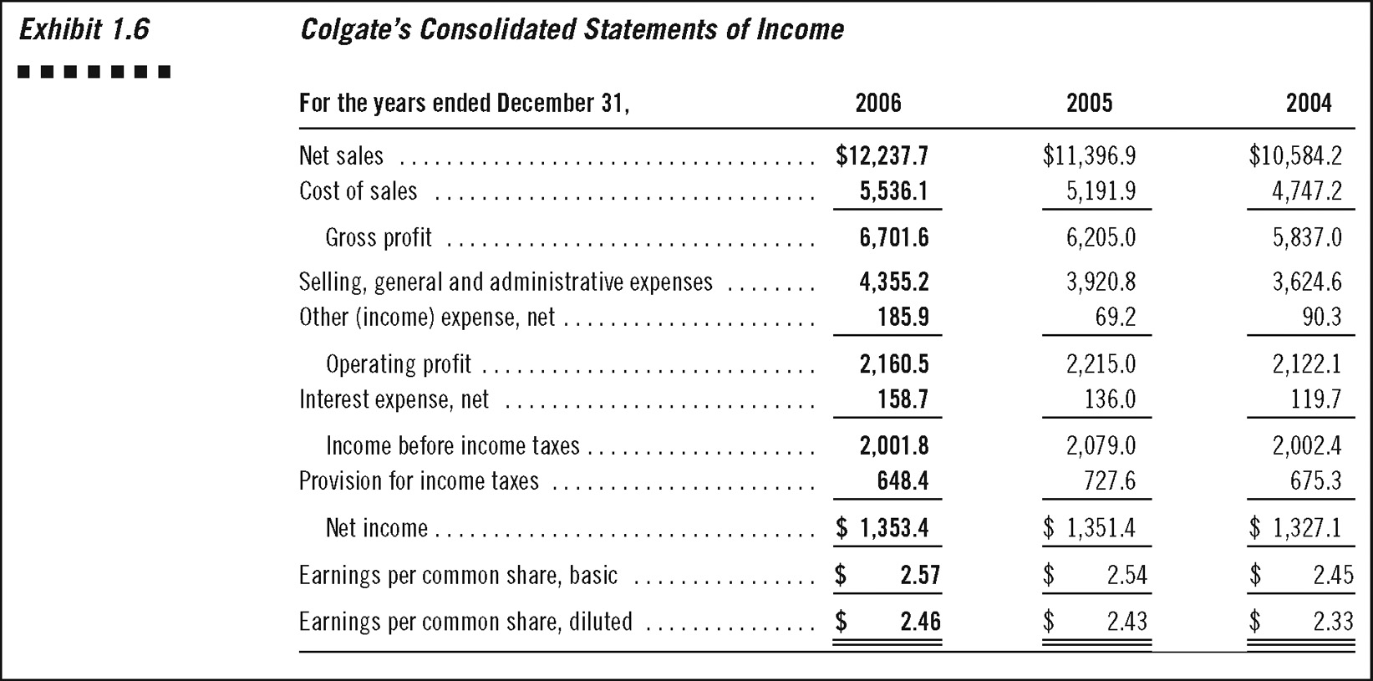
1-13
Notes:
13

Slide 14
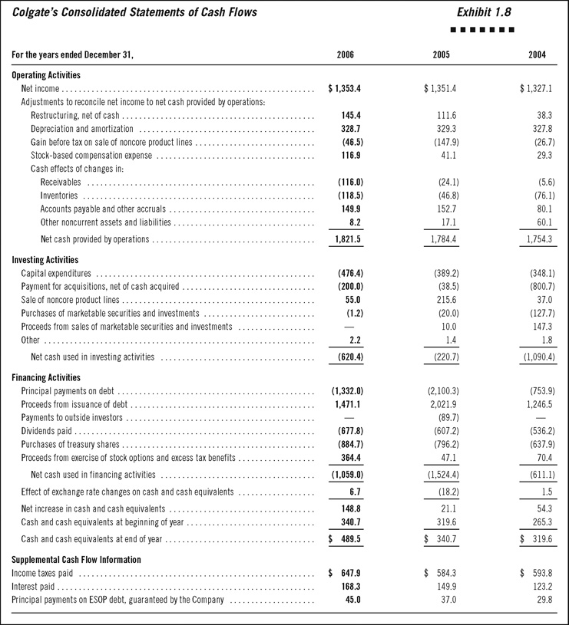
1-14
Notes:
14

Slide 15
Links between financial statements
Balance Sheet
Income Statement
Statement of Cash Flows
Revenues and expenses affect earnings and adjusted earnings are reported in retained earnings account on the balance sheet.
Cash transactions in the statement of cash flows are summarized in the cash balance on the balance sheet.
All revenue and expense accounts affect one or more balance sheet accounts.
Notes:
15

Slide 16
Additional Information (Beyond Financial Statements)
Annual Report
A comprehensive report on a company’s activities throughout the preceding year. Annual reports are intended to give shareholders and other interested people information about the company's activities and financial performance.
Management Report
The purposes of this report are to reinforce:
- Senior management’s responsibilities for the company’s financial and internal control system
- The shared roles of management, directors, and the auditor in preparing financial statements.
Auditor Report
- An opinion on whether or not the company’s financial statements are prepared in conformity with generally accepted accounting principles.
- A review of the auditor’s report to ascertain whether the company received an unqualified opinion
Notes:
16

Slide 17
Additional Information (Beyond Financial Statements)
Explanatory Notes
Notes are a means of communicating additional information regarding items included or excluded from the body of the statements.
Explanatory notes include information on: Accounting Principles and methods employed; detailed disclosures regarding individual financial statement items; commitments and contingencies; business combinations, transactions with related parties, legal proceedings, significant customers; stock options..
Proxy Statements
A proxy statement contains information necessary for shareholders in voting on matters for which the proxy is solicited. Proxy statements contain a wealth of information regarding a company including
The identity of shareholders owning 5% or more of outstanding shares
The biographical information on the board of directors
Compensation arrangements, employee benefit plans
Prospectus
A prospectus is a disclosure document that describes a financial security for potential buyers.
Notes:
17

Slide 18
Analysis Tools
Comparative financial statement analysis
Common-size financial statement analysis

Slide 19
Comparative analysis
Year-to-Year Change Analysis
Index-Number Trend Analysis

Slide 20
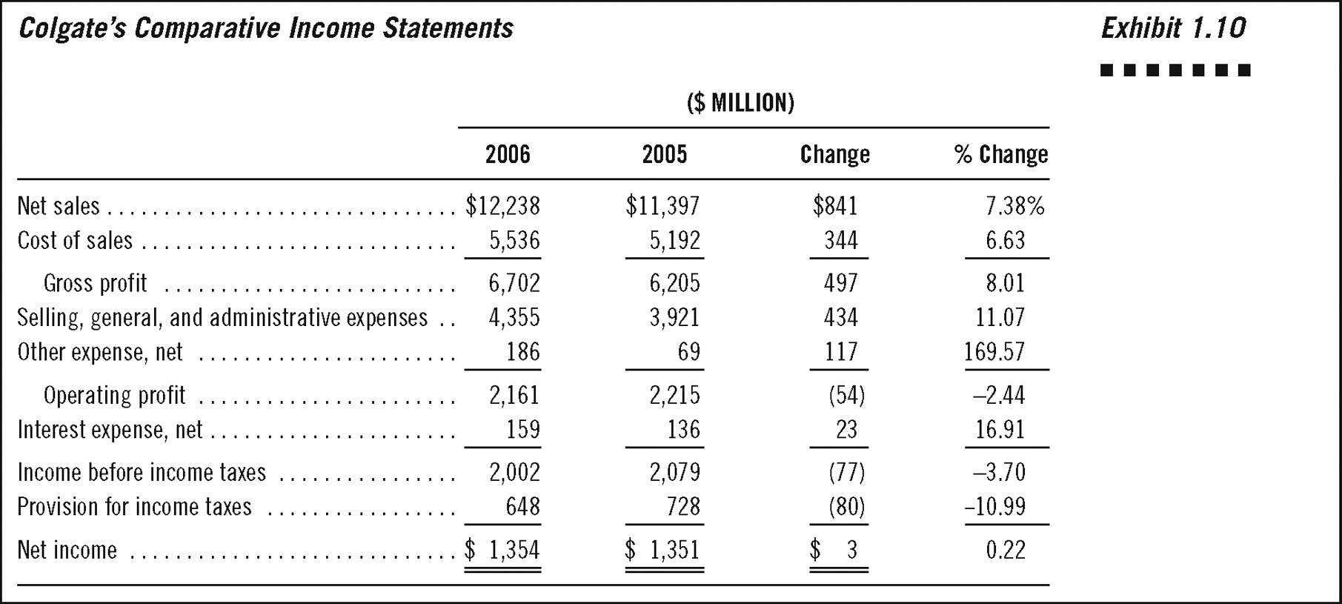
Year-to-Year Change Analysis
Comparing financial statements over relatively short time periods – two to three years – is usually performed with analysis of year-to-year changes in individual accounts. It has the advantage of presenting changes in absolute dollar amounts as well as in percentages.

Slide 21
Why do analysts usually compute both changes in absolute dollar amounts and percentages?

Slide 22
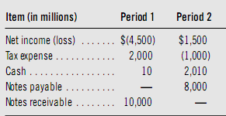

Slide 23
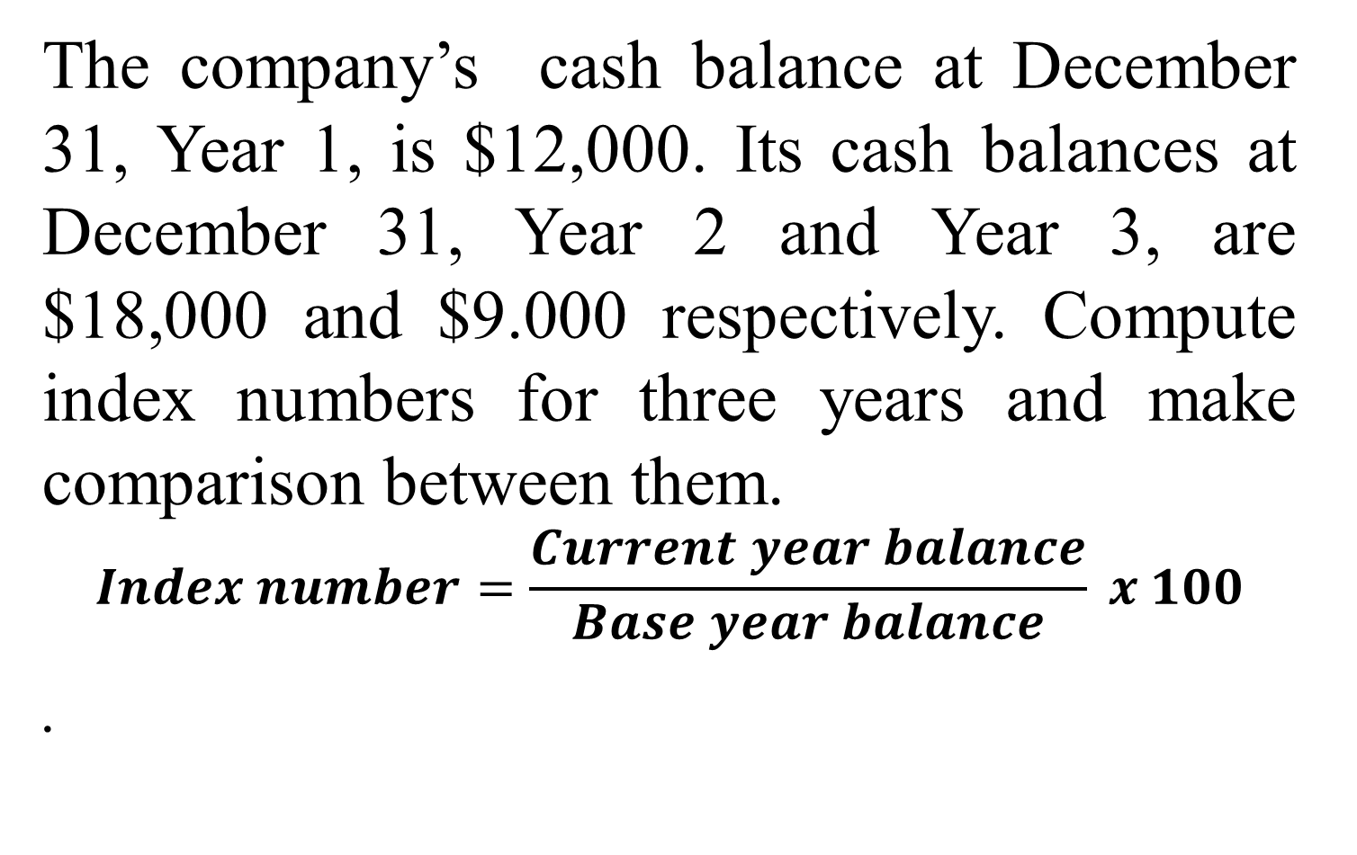
Index-Number Trend Analysis
The company’s cash balance at December 31, Year 1, is $12,000. Its cash balances at December 31, Year 2 and Year 3, are $18,000 and $9.000 respectively. Compute index numbers for three years and make comparison between them.
$$Index number=\frac{Current year balance}{Base year balance} x 100$$
.

Slide 24
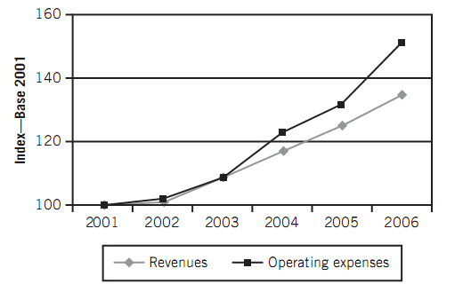

Slide 25
Comparative financial statement analysis
Review consecutive balance sheets, income statements or statements of cash flows from period to period.
Direction, speed, & extent of a trend
Comparing trends in related items
Horizontal analysis

Slide 26
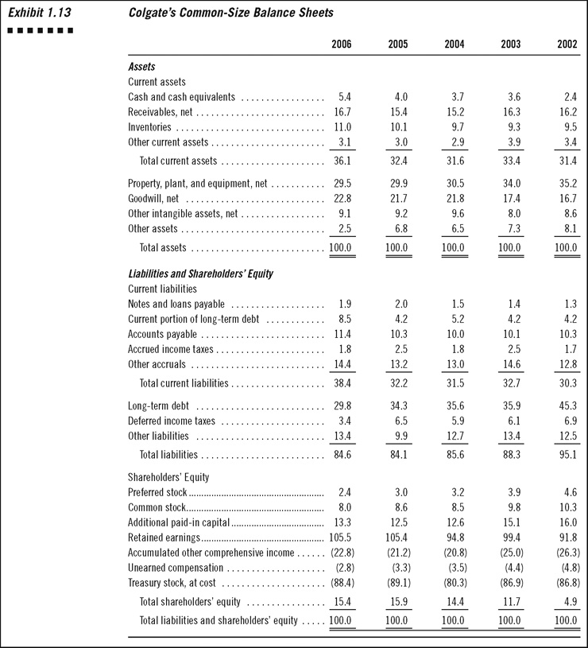
Common-Size Analysis
Notes:
26

Slide 27
Common-Size Analysis
Sources of financing – including the distribution of financing across current liabilities, noncurrent liabilities, and equity
Composition of assets – including amounts for individual current and noncurrent assets
*Common-size analysis of a balance sheet is often extended to examine the accounts that make up specific subgroups

Slide 28
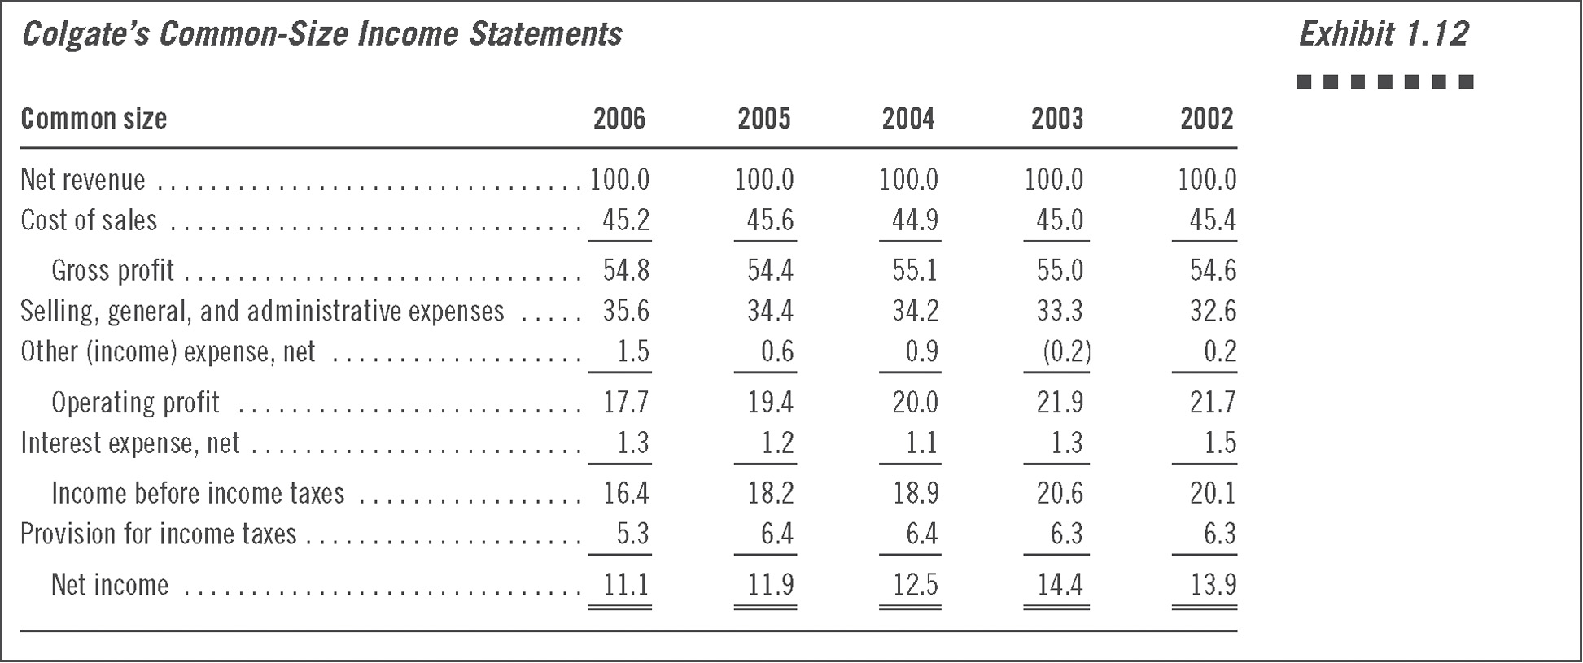
Common-Size Analysis
Notes:
28

Slide 29
Common-Size Analysis
Understanding internal makeup of financial statements
Intercompany comparisons
Failure to reflect the relative sizes of the companies under analysis
Time comparisons of a company’s common-size statements
Notes:
29

Slide 30
